Slide 1

ANALYSIS OF 2024 ELECTION USING POWERBI
Presented By : V Merlin vensiya

Slide 2
1
OBJECTIVE
The objective of this task is to analyze the 2024 election data to gain insights into the election results, party performance, and voter trends across various constituencies. You will use Power BI or Tableau to create interactive visualizations and dashboards that will help stakeholders understand the election outcomes and the dynamics between different political alliances.

Slide 3

DATA DESCRIPTION
3
Election Results Data:
_id: Unique identifier
State: Name of the state
Const. No.: Constituency number
Constituency: Name of the constituency
Leading Candidate: Name of the leading candidate
Leading Party: Name of the leading party
Trailing Candidate: Name of the trailing candidate
Trailing Party: Name of the trailing party
Margin: Vote margin between leading and trailing candidates
Status: Status of the election result (e.g., Won, Lost, Leading, Trailing)
Party Alliance Data:
Party Name: Name of the political party
Alliance Name: Name of the political alliance the party belongs to

Slide 4
4
DATA INTEGRATION
Steps:
Load both datasets into Power BI or Tableau.
Perform a merge/join operation on the Leading Party and Trailing Party columns from the election results data with the Party Name column from the party alliance data.
First
Combine election results data with party alliance data.
Second
Merge Leading Party and Trailing Party with Party Name to get Alliance Name

Slide 5
5
DATA CLEANING
1
Check for Missing Values:
Identify and handle missing values in critical columns like State, Constituency, Leading Candidate, Leading Party, etc.
Use appropriate techniques to fill or remove missing data.
2
Correct Inconsistencies:
Ensure consistency in party names and other categorical data.
Standardize the format of textual data.
3
Data Validation:
Cross-check the data against any known benchmarks or additional sources to ensure accuracy.

Slide 6
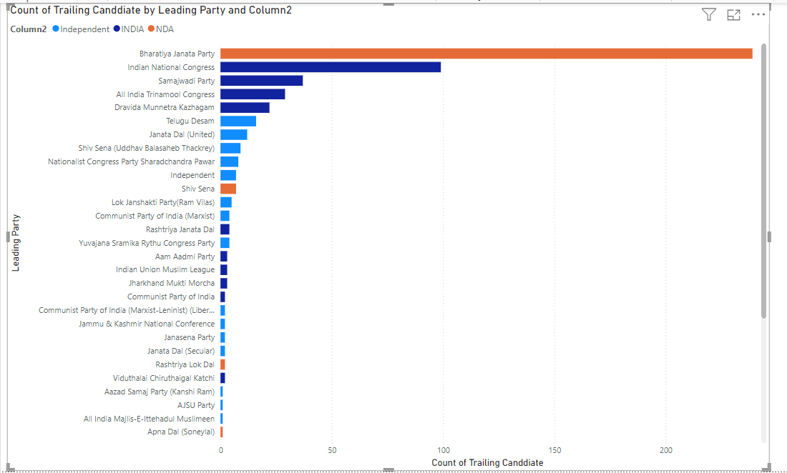
6
﻿RESULT
Overall Results:
Summary of total seats won by each party and alliance.
State-wise Analysis:
Performance of leading parties and alliances across states.
Constituency-wise Analysis:
Margins of victory/defeat in various constituencies.
Party and Alliance Comparison:
Compare seats won, margins, and status.

Slide 7
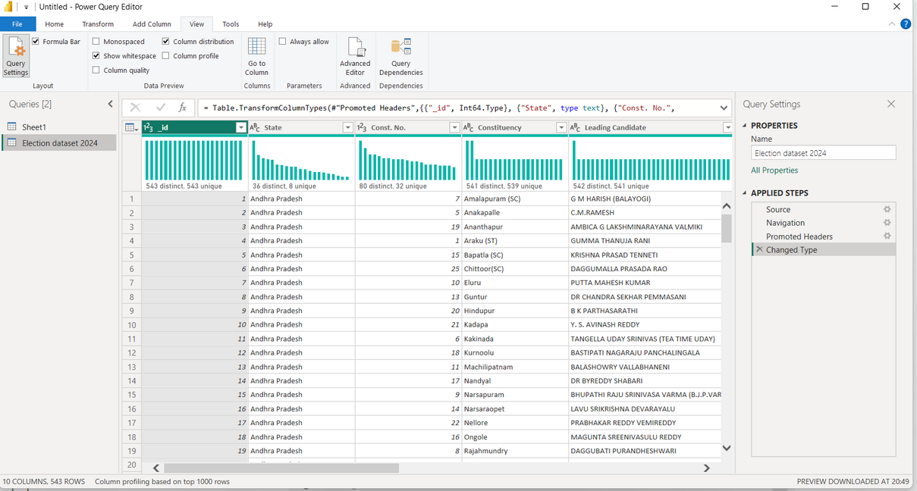
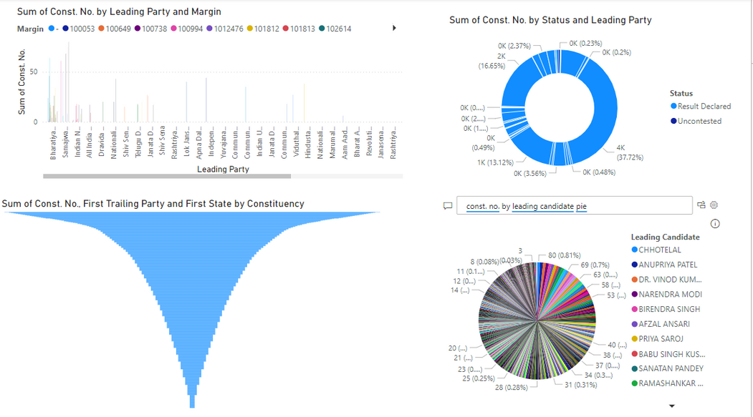

Slide 8
RECOMMENDATIONS
6
Based on the insights derived from the analysis, here are some recommendations for parties to improve their performance in future elections:
1. Strengthen Alliances
NDA and INDIA Alliances:
Focus on consolidating and strengthening alliances to cover more constituencies.
Foster collaboration and joint campaigns among alliance members.
2. Targeted Campaign Strategies
Region-Specific Campaigns:
Develop targeted campaigns addressing regional issues and concerns.
Leverage local leaders and influencers to gain voter trust and support.
3. Address Voter Concerns
Policy and Governance Focus:
Address key voter concerns such as unemployment, healthcare, and education.
Showcase successful policies and governance initiatives to build credibility.

Slide 9
7
FOCUS ON
Improve Voter Outreach
Community Engagement:
Enhance voter outreach programs to increase voter participation.
Conduct grassroots campaigns to understand and address local issues.
Engage with Youth and First-Time Voters
Youth Engagement Programs:
Create initiatives to engage with youth and first-time voters.
Use social media and digital platforms to connect with younger demographics.

Slide 10
Overall Performance
Total Constituencies Won by Each Alliance:
NDA: Dominates with a significant number of constituencies won, showcasing their strong presence and voter base.
INDIA: Secured a substantial number of constituencies, indicating their competitive edge in various regions.
Independent: Managed to win a few constituencies, reflecting localized support and influence.
Regional Performance
Top Performing Parties by Region:
Northern Region:
NDA: Strong performance in states like Uttar Pradesh and Haryana.
INDIA: Competitive in Punjab and Delhi.
Southern Region:
INDIA: Dominant in Tamil Nadu and Kerala.
NDA: Significant presence in Karnataka.
Eastern Region:
NDA: Leading in states like Bihar and Odisha.
INDIA: Competitive in West Bengal and Jharkhand.
Western Region:
NDA: Strong in Maharashtra and Gujarat.
INDIA: Making strides in Rajasthan.
Close Contests:
Identified regions with narrow margins of victory, indicating potential areas for alliances to strengthen their campaigns.

Slide 11
THANK YOU
Presented By : V Merlin vensiya

